Slide 1
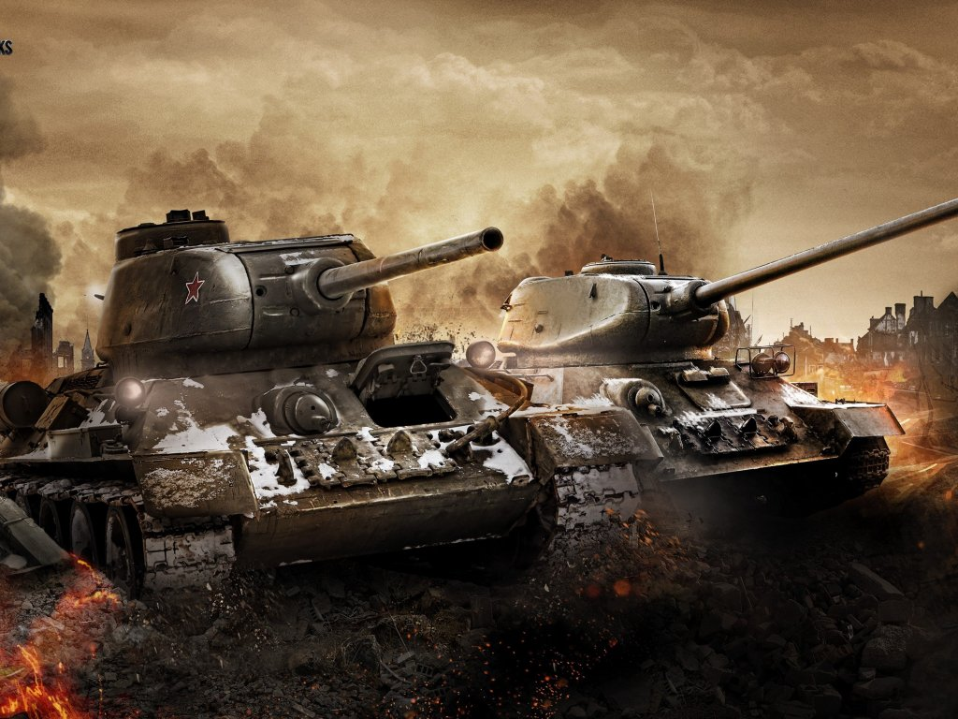
Combat evolved

Slide 2
Brief requirements
Modern design
Different game mode
Collision detection
Game Play Time
Sounds
Exit Screen & Pause Screen
Log File

Slide 3
Top level view of the system
Game loop and initialization

Slide 4
Top level view of the system
Base object
Tank
'Dumb' player
Player
Power Up
Speed boost
AI player
Speed penalty
Fire rate boost
Fire rate penalty
Bubble shield
Wall
Bullet
Object structure

Slide 5
Collision Detection
intersection = non-empty union between areas
if intersection is forecast….............
jump to edge
create 4 ‘phantom’ bullets to determine
which edge of the wall hit
Means that…
Bullets bounce exactly off walls
Bullets bounce off at correct angle for every situation

Slide 6
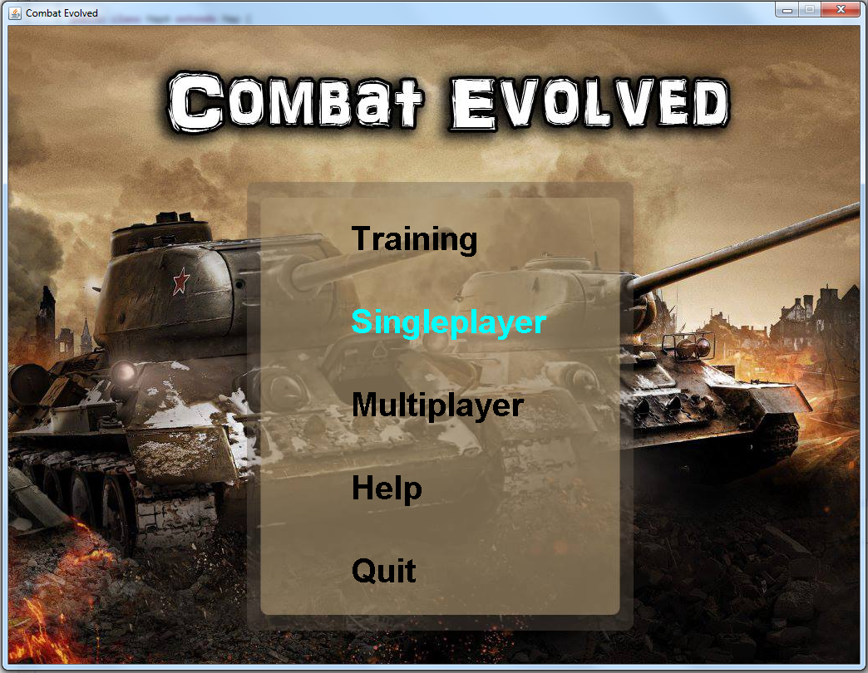
GAME PLAY

Slide 7
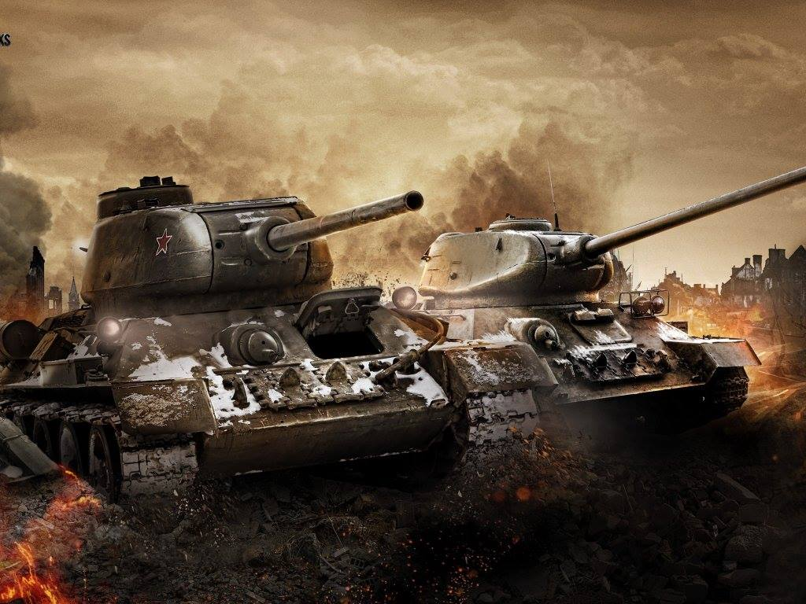

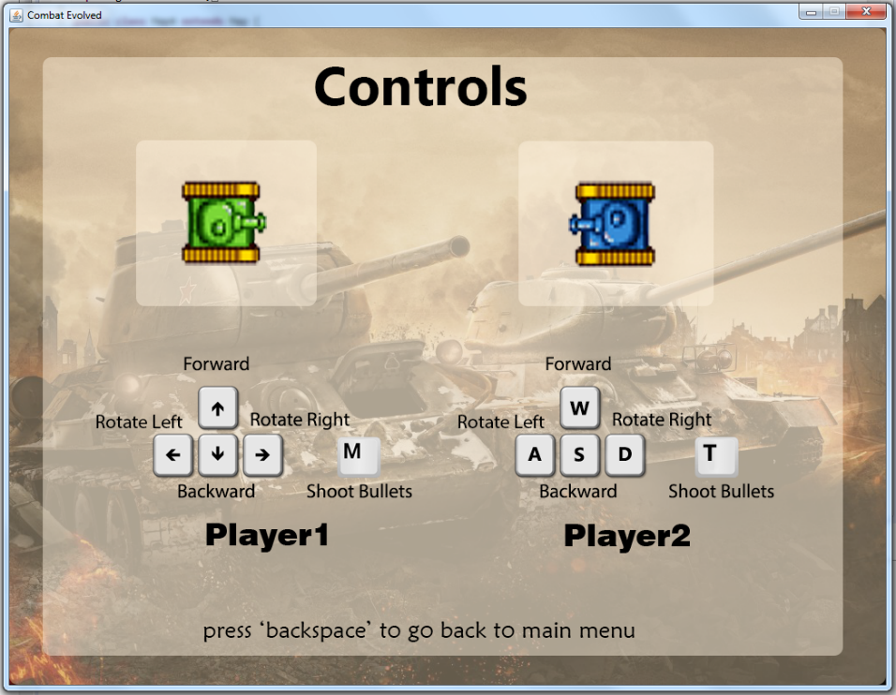
Gui design
Main menu
Help menu

Slide 8
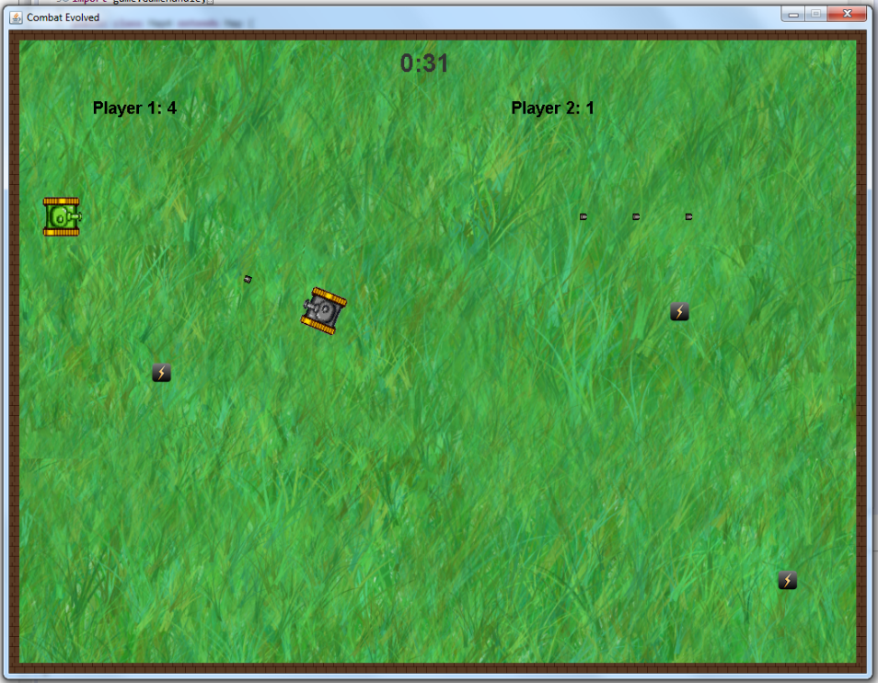
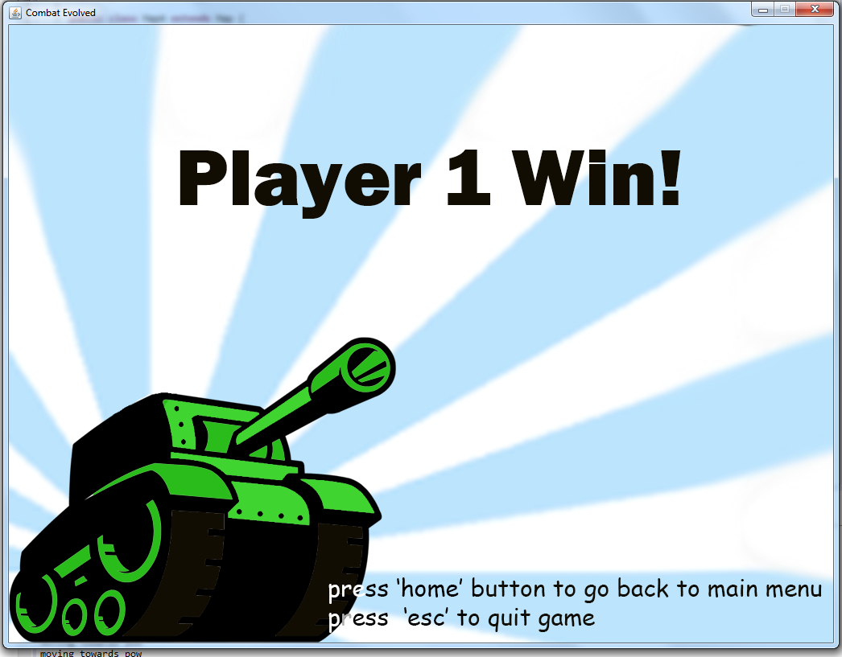
Gui design
While Playing (level 4)
Player 1 win & End game State

Slide 9
Special feature
Modern graphics
Sprite animation
Help screen
Proper collision detection
Different modes for AI (blitz mode , smart mode)
Toggle mode

Slide 10
Different with others
Sprite animation
Smart mode of AI
Toggle mode

Slide 11
Why should client pay us
Met all the requirements
Modern Graphic
Organized User Interface
Animated tank
Smart AI
Toggle AI mode

